Slide 1
Role of Statistics in Research

Slide 2
Role of Statistics in research
Validity
Will this study help answer the research question?
Analysis
What analysis, & how should this be interpreted and reported?
Efficiency
Is the experiment the correct size,
making best use of resources?
Notes:
Give examples of each

Slide 3
Validity
Will the study answer the research question?
Surveys
select a sample from a population
describe, but can’t explain
can identify relationships, but can’t establish causality

Slide 4
Surveys & Causality
PGRM 2.2.1
In a survey:
farm income increased by 10% for each increase in fertiliser of 30 kg/ha
Is this relationship causal?

Slide 5
Surveys & Causality
PGRM 2.2.1
In a survey:
farm income increased by 10% for each increase in fertiliser of 30 kg/ha
Is this relationship causal?
Not necessarily,
other factors are involved:
Managerial ability
Farm size
Educational level of farmer
Fertiliser level may be related to these other possible causes, and may (or may not) be a cause itself

Slide 6
Survey Unit
Example: In an survey to assess whether Herefords have a higher level of calving difficulty than Friesians, the individual cow is the survey unit.

Slide 7
Survey Unit
Example: In a survey to assess the height of Irish males vs English males, the unit is the individual male in that one would sample a number of males of each country and take their heights rather than measure one male from each country many times.

Slide 8
Designed Experiments

Slide 9
Comparing treatment effect
Effect = difference between treatments
A well designed experiment leads to conclusion:
Either the treatments have produced the observed effect
or
An improbable (chance < 1:20, 1:100 etc) event has occurred
Technically we calculate a p-value of the data:
i.e. the probability of obtaining an effect as large as that observed when in fact the average effect is zero

Slide 10
Essential elements of a designed experiment
Notes:
Effect of increased CO2 – the different levels are the treatments
Units treated in the same way differ! – so what is observed may be due by chance to an exceptional set of units being involved
Ask – how would you do this eg in groing plants in small seed trays (30available to compare 3 treatments)

Slide 11
Essential elements of a designed experiment
COMPARATIVE The objective is to compare a number (>1) of treatments
REPLICATION
Each treatment is tested on more than one experimental unit
RANDOMISATION
experimental units are allocated to treatments at random
Notes:
Effect of increased CO2 – the different levels are the treatments
Units treated in the same way differ! – so what is observed may be due by chance to an exceptional set of units being involved
Ask – how would you do this eg in groing plants in small seed trays (30available to compare 3 treatments)

Slide 12
Replication
Each treatment is tested on more than one experimental unit (the population item that receives the treatment)
To compare treatments we need to know the inherent variability of units receiving the same treatment
background noise
this might be a sufficient explanation for the observed differences between treatments

Slide 13
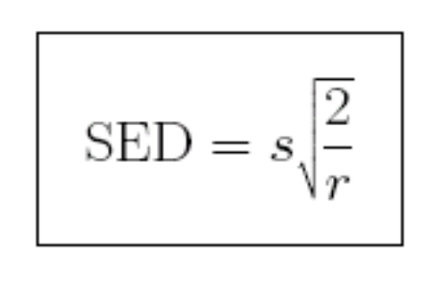
Replication: 2 facts
Our faith in treatment means will:
Increase with greater replication
Decrease when noise increases
In particular the standard error of difference (SED) between 2 treatment means where:
r = (common) replication;
s = typical difference between observations
from same treatment:
SED is the typical difference between 2 treatment means where the treatments don’t differ

Slide 14
Validity & Efficiency
Validity: The first requirement of an experiment is that it be valid. Otherwise it is at best a waste of time and resources and at worst it is misleading.
Efficiency: the use of experimental resources to get the most precise answer to the question being asked, is not an absolute requirement but is certainly desirable because cost is an important aspect of any experiment.

Slide 15
Pseudoreplication
- how to invalidate your experiment!
Treating multiple measurements on the same unit as if they were measurements on independent units
See PGRM Examples 1 – 3 pg 2-5
Notes:
Discussion

Slide 16
Pseudoreplication
Example: In an experiment testing the effect of a hormone treatment on follicle development, the cow is the experimental unit, not the follicle.

Slide 17
Example:
In an experiment to compare three cultivars of grass, a rectangular tray was assigned at random to each treatment. Trays were filled with John Innes Number 2 compost and 54 seedlings of the appropriate cultivar were planted in a rectangular pattern in each tray.
After ten weeks the 28 central plants were harvested, dried and weighed and the 84 plant weights recorded. What was the experimental unit?

Slide 18
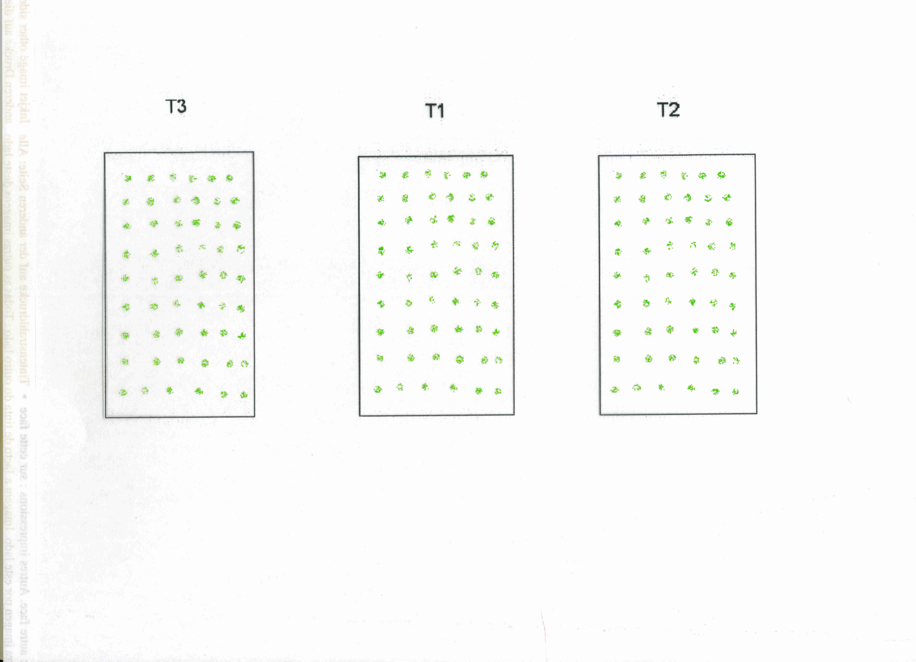

Slide 19
Example:
In an experiment to compare three cultivars of grass, 7 square pots were assigned at random to each treatment. Pots were filled with John Innes number 2 compost and 16 seedlings of the appropriate cultivar planted in a square pattern in each pot.
After ten weeks the 4 central plants were harvested, dried and weighed. Thus 84 plant weights were recorded. What is the experimental unit and what should be analysed?

Slide 20
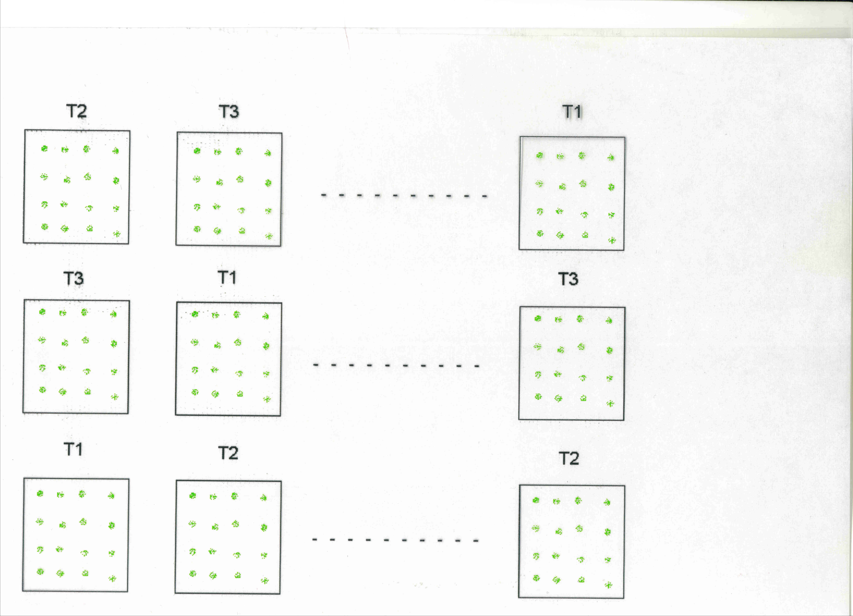

Slide 21
Randomisation
- allocating treatments to units
Ensures the only systematic force working on experimental units is that produced by the treatments
All other factor that might affect the outcome are randomly allocated across the treatments

Slide 22
Randomisation - how it works
What do we mean by ‘In a randomised experiment any difference between the mean response on different treatments is due to treatment difference or random variation or both’?

Slide 23
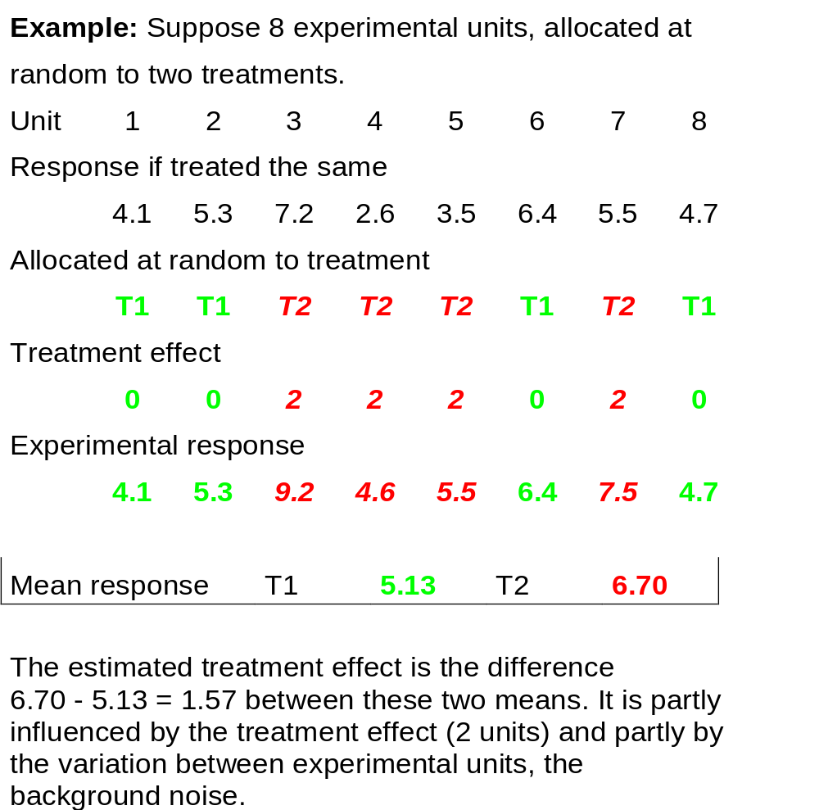

Slide 24
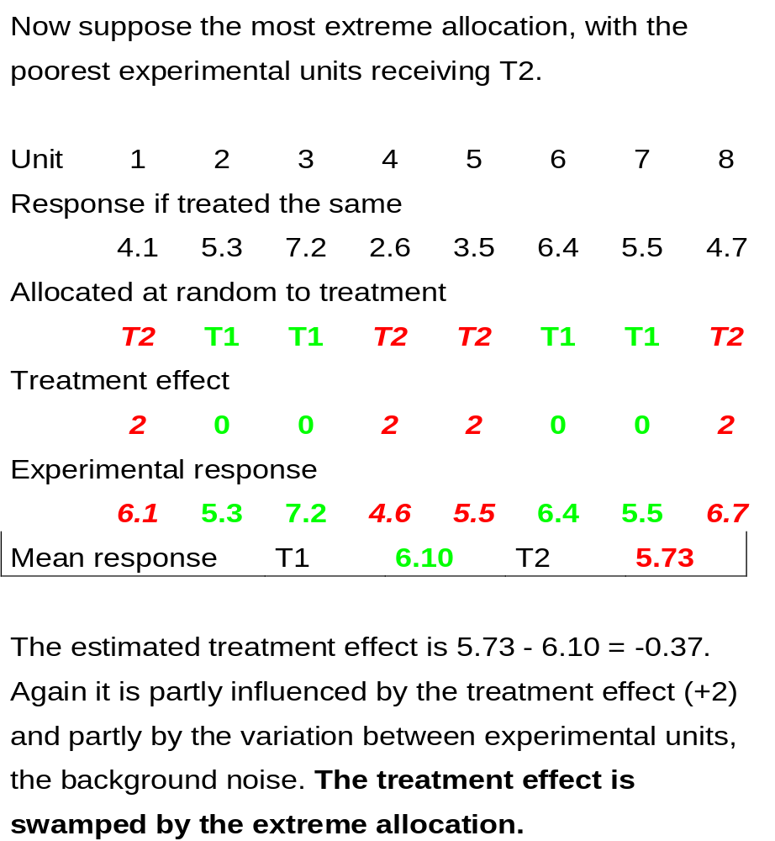

Slide 25
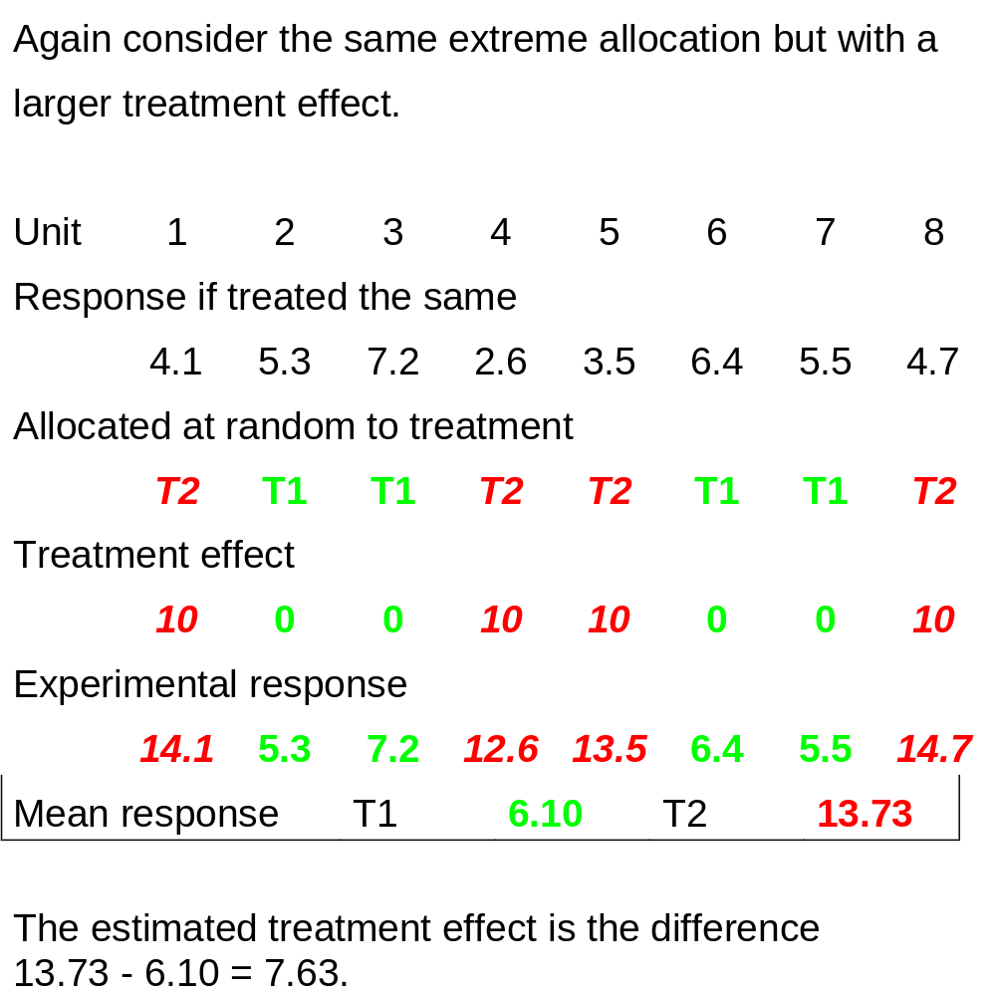

Slide 26
Three points:
The observed treatment difference is due only to treatment effect and variation.
If the treatment effect is large relative to the background noise then even an extreme allocation will not obscure the treatment effect. (Signal/Noise ratio).
If the number of experimental units is large then a treatment effect will usually be more obvious, since an extreme allocation of experimental units is less likely.
With 20 experimental units, unlikely that the 10 worst and the 10 best allocated to different treatments.

Slide 27
Defective Designs
PGRM pg 2-8
Examples 1 – 7

Slide 28
Tests of Hypotheses - Tests of Significance
Survey: Are the observed differences between groups compatible with a view that there are no differences between the populations from which the samples of values are drawn?
Designed experiments: Are observed differences between treatment means compatible with a view that there are no differences between treatments?

Slide 29
Tests of Hypotheses - Tests of Significance
Designed experiment - only two explanations for a negative answer, difference is due to the applied treatments or a chance effect
Survey is silent in distinguishing between various possible causes for the difference, merely noting that it exists.

Slide 30
Example
An experiment on artificially raised salmon compared two treatments and 20 fish per treatment. Average gains (g) over the experimental period were 1210 and 1320. Variation between fish within a group was RSE = 135g
Did treatment improve growth rate?

Slide 31
Procedure
a) NULL HYPOTHESIS Treatments have no effect and any difference observed between groups treated differently is due to chance (variation in the experimental material)'
b) Measure
-the variation between groups treated differently
-the variation expected if due solely to chance
c) TEST STATISTIC Compare the two measures of variation. Do treatments produce a 'large' effect?

Slide 32
d) The observed difference could have occurred by chance. Statistical theory gives rules to determine how likely a given difference in variation is liable to be by chance.
e) SIGNIFICANCE TEST Face the choice.
-This difference in variation could have occurred by chance with probability ? (5%, 1%, etc)
OR
-There is a real difference (produced by treatment).
f) GOOD EXPERIMENTAL PROCEDURE makes sure in experiments that there is no other possible explanation.

Slide 33
Example: - The t test
An experiment on artificially raised salmon compared two treatments and 20 fish per treatment. Average gains (g) over the experimental period were 1210 and 1320. Variation between fish within a group was RSE = 135g
Did treatment improve growth rate?

Slide 34
Example
a) NULL HYPOTHESIS - Treatment does not affect salmon growth rate
b) Observed difference between groups
1320 - 1210 = 110
Variation expected solely from chance
135 x (2/20).5 = 42.7
c) Test Statistic
t = 110/42.7 = 2.58
d) Statistical theory (t tables) shows that the chance of a value as large as 2.58 is about 1 in 100
e) Make the choice
f) Are there other possible explanations?

